Slide 1
Following the paths of Slavic aspectual prefixes
Laura A. Janda

Slide 2

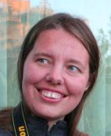

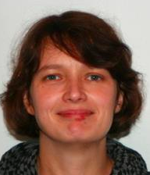
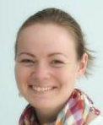


Collaborators
Anna
Endresen
Olga
Lyashevskaya
Tore
Nesset
Julia
Kuznetsova
Anastasia
Makarova
Stephen
Dickey
Svetlana
Sokolova

Slide 3
Related publications
Janda, Laura A. “Polysemy of affixes: A Slavic Perspective”, forthcoming in Wiley Blackwell Companion to Morphology, edited by Antonio Fábregas. 26pp.
Dickey, Stephen M., Laura A. Janda. 2015. “Slavic Aspectual Prefixes and Numeral Classifiers: Two Kinds of Lexico-Grammatical Unitizers”. Lingua 168, 57-84. DOI: 10.1016/j.lingua.2015.09.005
Janda, Laura A., Anna Endresen, Julia Kuznetsova, Olga Lyashevskaya, Anastasia Makarova, Tore Nesset, Svetlana Sokolova. 2013. Why Russian aspectual prefixes aren’t empty: prefixes as verb classifiers. Bloomington, IN: Slavica Publishers.

Slide 4
Overview
Cognitive Linguistics
Construction Grammar: Prefix + Verb Constructions
Polysemy: Radial Categories
Verbal Prefixes: Paths as Prototypes and Polysemy
Meanings with verbs of motion
Extensions via metaphor and metonymy
Semantic relationships to verbs
Verb Classifiers
Analogy to “Numeral” (noun) Classifiers
Sortal and Mensural Classifiers

Slide 5
Cognitive Linguistics

Slide 6
Construction Grammar: Prefix + Verb Constructions
All linguistic expressions are constructions
Constructions are the basic unit of language
A language is a system of constructions, termed a “constructicon” (cf. Lyngfeldt et al. 2018)
Constructions are defined as conventionalized pairings of form and meaning (also called “symbolic assemblies” by Langacker)
Morphemes such as prefixes are the minimal type of construction; cf. Goldberg’s (2006: 18) and Langacker (2008: 16) definition of the morpheme as “an expression whose symbolic complexity is zero, i.e. it is not at all analyzable into smaller symbolic components”.

Slide 7

Examples of Russian constructions
Prefix + verb construction
morphemes
-ть = INF, за- = ingressive
lexemes
танцевать ‘dance’, затанцевать ‘begin to dance’
multi-word idioms where all slots are fixed
танцевать от Адама ‘start from the very beginning’
multi-word expressions with open slots
VP pod NP-Acc
Она танцевала под музыку ‘She danced to the music’
larger discourse units
See the Russian Constructicon: https://constructicon.github.io/russian/

Slide 8
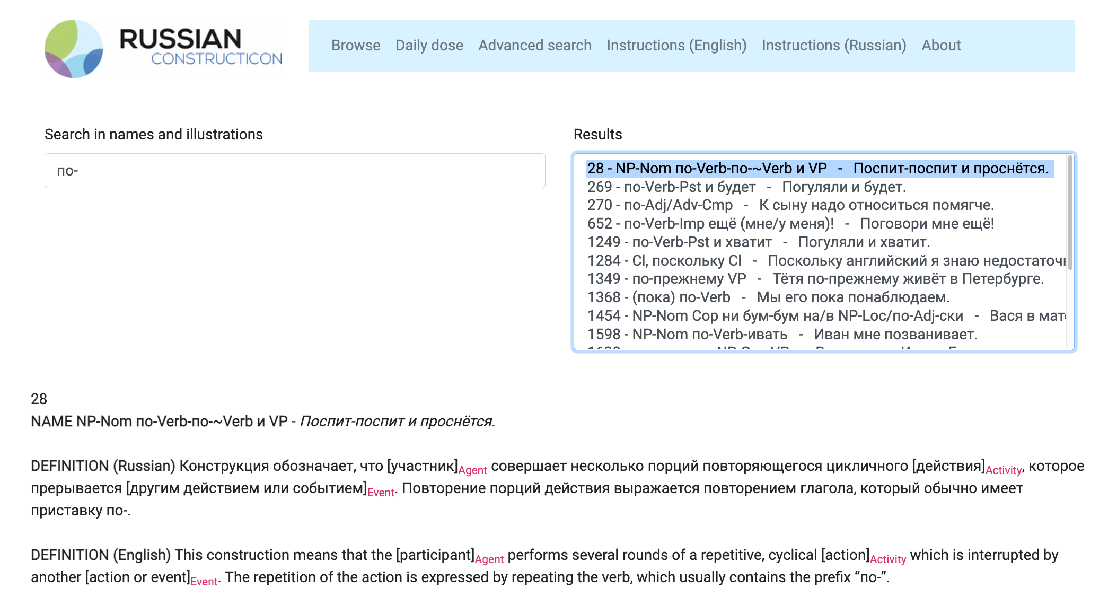

Slide 9
Polysemy: Radial Categories
Polysemy can be described as a radial category with a central prototypical meaning and a network of extensions of that meaning that are relatively more or less peripheral (Lakoff 1987)
Peripheral meanings are related directly or indirectly to the prototype, and the structure of the network is coherent rather than haphazard
Metaphor and metonymy motivate the structure of polysemy
Metaphor: a meaning is mapped from one domain (a source domain, often the physical environment) to another (a target domain) (Lakoff and Johnson 1980)
Metonymy: a meaning shifts to follow associations from source to target within a single domain (Peirsman and Geeraerts 2006)

Slide 10
2. CRUSH
раз-давить
[CRUSH-crush]
‘crush’
7. UN-
раз-грузить
[UN-load]
‘unload’
Example of polysemy:
Russian prefix раз-
Prototype
1. APART
раз-резать
[APART-cut]
‘cut up’
3. SPREAD
раз-ветвиться
[SPREAD-branch]
‘branch out’
4. SWELL
раз-дуть
[SWELL-blow]
‘inflate’
5. DISSOLVE
рас-таять
[DISSOLVE-melt]
‘melt’
6. EXCITEMENT
рас-калить
[EXCITEMENT-
heat]
‘make red-hot’

Slide 11
Verbal Prefixes: Paths as Prototypes and Polysemy

Slide 12
Russian has 17 perfectivizing prefixes
Prefix | Prototypical path meaning | Related meanings
до‑ | reach | excess, add
из‑ | out of a container | empty a container, exhaustive result, exhaust a surface, negative exhaustion, make out of, decline/deviate, acquire
на‑ | surface | accumulate
o(б)‑ | around | pass, overdo, mistake, affect many, affect a surface, envelop, impose/acquire a new feature
oт‑ | depart | bounce, unstick, remove, make non-functional, stop at the endpoint
пере‑ | transfer | superiority, overdo, redo, duration/overcome, bridge, turn over, mix, divide, seriatim, thorough
пo‑ | set out | result, some, distribute
под‑ | apply to bottom | horizontal approach, adjust, increment, secretly, minimal
при‑ | arrive | attach, add, attenuate
про‑ | through | thorough, duration, distance, pass
раз‑ | apart | crush, spread, swell, soften/dissolve, excitement, un‑
с‑ | down | together, once
у‑ | move away | move downwards, control, reduce, harm, perceive, place/fit, keep/save, cover completely, depart from norm
в‑ | into
в(o)з‑ | move upward | agitate, resist, rebuild
вы‑ | out of a container | empty a container, exhaustive result, exhaust a surface, negative exhaustion, create an image on a surface, make out of, decline/deviate, acquire, endure
зa‑ | deflect | excess, begin, exchange, attachment, cover, fill, change to a fixed state

Slide 13
Russian has 17 perfectivizing prefixes
Prefix | Prototypical path meaning | Related meanings
до‑ | reach | excess, add
из‑ | out of a container | empty a container, exhaustive result, exhaust a surface, negative exhaustion, make out of, decline/deviate, acquire
на‑ | surface | accumulate
o(б)‑ | around | pass, overdo, mistake, affect many, affect a surface, envelop, impose/acquire a new feature
oт‑ | depart | bounce, unstick, remove, make non-functional, stop at the endpoint
пере‑ | transfer | superiority, overdo, redo, duration/overcome, bridge, turn over, mix, divide, seriatim, thorough
пo‑ | set out | result, some, distribute
под‑ | apply to bottom | horizontal approach, adjust, increment, secretly, minimal
при‑ | arrive | attach, add, attenuate
про‑ | through | thorough, duration, distance, pass
раз‑ | apart | crush, spread, swell, soften/dissolve, excitement, un‑
с‑ | down | together, once
у‑ | move away | move downwards, control, reduce, harm, perceive, place/fit, keep/save, cover completely, depart from norm
в‑ | into
в(o)з‑ | move upward | agitate, resist, rebuild
вы‑ | out of a container | empty a container, exhaustive result, exhaust a surface, negative exhaustion, create an image on a surface, make out of, decline/deviate, acquire, endure
зa‑ | deflect | excess, begin, exchange, attachment, cover, fill, change to a fixed state

Slide 14
2. CRUSH
раз-давить
[CRUSH-crush]
‘crush’
7. UN-
раз-грузить
[UN-load]
‘unload’
Example of polysemy:
Russian prefix раз-
Prototype
1. APART
раз-резать
[APART-cut]
‘cut up’
3. SPREAD
раз-ветвиться
[SPREAD-branch]
‘branch out’
4. SWELL
раз-дуть
[SWELL-blow]
‘inflate’
5. DISSOLVE
рас-таять
[DISSOLVE-melt]
‘melt’
6. EXCITEMENT
рас-калить
[EXCITEMENT-
heat]
‘make red-hot’

Slide 15
1. apart
Шлиппенбах захохотал так, что разлетелись бумажные салфетки.
‘Schlippenbach started to laugh so hard that the paper napkins flew in all directions.’
[Сергей Довлатов. Чемодан (1986)]
Metaphor
Metonymy
Наше тяжелое матерьяльное положение окончательно расшатало наши нервы.
‘Our difficult financial situation definitively shattered our nerves.’
[А. М. Ремизов. Взвихренная Русь (1917-1924)]
Виктор взял чемодан в левую руку, правой ещё пригубил на дорожку коньячку и раскланялся.
‘Viktor took his suitcase in his left hand, used his right to take a swig of cognac for the road and took a parting bow.’
[Василий Шукшин. Печки-лавочки (1970-1972)]

Slide 16
1. apart
Metonymy
2. crush
Миша докурил сигарету до самого фильтра, и яростно растоптал ее каблуком.
‘Misha smoked his cigarette all the way down to the filter and furiously crushed it with his heel.’
[Евгений Прошкин. Механика вечности (2001)]

Slide 17
1. apart
Metonymy
3. spread
Раскатала тесто, поставила пирог в духовку, и тут позвонили в дверь...
‘She rolled out the dough, put the pie in the oven, and right then someone rang the doorbell..’
[Симон Соловейчик. Ватага «Семь ветров» (1979)]
Metaphor
я разработал стратегический план, который вам станет ясен впоследствии.
‘I have worked out a strategic plan, which will subsequently become clear to you.’
[Владимир Войнович. Иванькиада, или рассказ о вселении писателя
Войновича в новую квартиру (1976)]

Slide 18
3. spread
Metonymy
4. swell
Средний палец у него распух от удара.
‘His middle finger swelled up from the blow.’
[Сати Спивакова. Не всё (2002)]
Metaphor
У нас есть категория людей, которые разбогатели и стали миллиардерами, как у нас говорят, в одночасье.
‘We have a category of people who got rich and became billionaires in one fell swoop as we say.’
[Валерий Лебедев. Отечество в опасности // Интернет-альманах «Лебедь», 2003.11.01]

Slide 19
4. swell
Metaphor
5. dissolve
Два дня сыпал снег, потом растаял, и полил дождь.
‘Snow was coming down for two days, then it melted, and then rain came pouring down.’
[Сергей Козлов. Правда, мы будем всегда? (1969-1981)]

Slide 20
3. spread
4. swell
Metonymy
6. excitement
Зинаида Николаевна … разогрела в духовке французский батон.
‘Zinaida Nikolaevna ... heated up the French baguette in the oven.’
[Ольга Новикова. Женский роман (1993)]
Metaphor
Сердце застучало. Я чуть не расплакался.
‘My heart started to pound. I almost burst into tears.’
[Григорий Горин. Иронические мемуары (1990-1998)]

Slide 21
1. apart
Metonymy
7. un-
Развязала веревки, которыми были спутаны его руки и ноги.
‘She untied the ropes that bound his hands and feet.’
[Татьяна Тронина. Никогда не говори «навсегда» (2004)]
Metaphor
Metaphor
Гурьев обиделся и раздумал нас провожать
‘Gur’ev took offense and changed his mind about accompanying us’
[Сергей Довлатов. Заповедник (1983)]
Профессор Дэйвид Пейдж первым (в 2003 году) расшифровал последовательность человеческой Y-хромосомы.
‘Professor David Page is the first person (in 2003) who decoded the sequence of the human Y chromosome.’
[Леонид Крайнов. Будущее мужской хромосомы // «Знание-сила», 2013]

Slide 22
Semantic relationships of prefixes to verbs
CONTRAST
COMPATIBILITY
OVERLAP
разлететься [APART-fly]
расшатать [APART-shake]
раскланяться [APART-bow]
раскатать [SPREAD-roll]
разработать [SPREAD-work]
развязать [UN-tie]
раздумать [UN-think]
разшифровать [UN-encode]
растоптать [CRUSH-stamp]
разбогатеть [SWELL-get.rich]
разогреть [EXCITEMENT-heat]
расплакаться [EXCITEMENT-weep]
распухнуть [SWELL-swell]
растаять [DISSOLVE-melt]

Slide 23
Semantic relationships of prefixes to verbs
CONTRAST
COMPATIBILITY
OVERLAP
разлететься [APART-fly]
расшатать [APART-shake]
раскланяться [APART-bow]
раскатать [SPREAD-roll]
разработать [SPREAD-work]
развязать [UN-tie]
раздумать [UN-think]
расшифровать [UN-encode]
растоптать [CRUSH-stamp]
разбогатеть [SWELL-get.rich]
разогреть [EXCITEMENT-heat]
расплакаться [EXCITEMENT-weep]
распухнуть [SWELL-swell]
растаять [DISSOLVE-melt]
Path meaning with motion verbs
Overlap with Natural Perfectives

Slide 24
Verb Classifiers

Slide 25

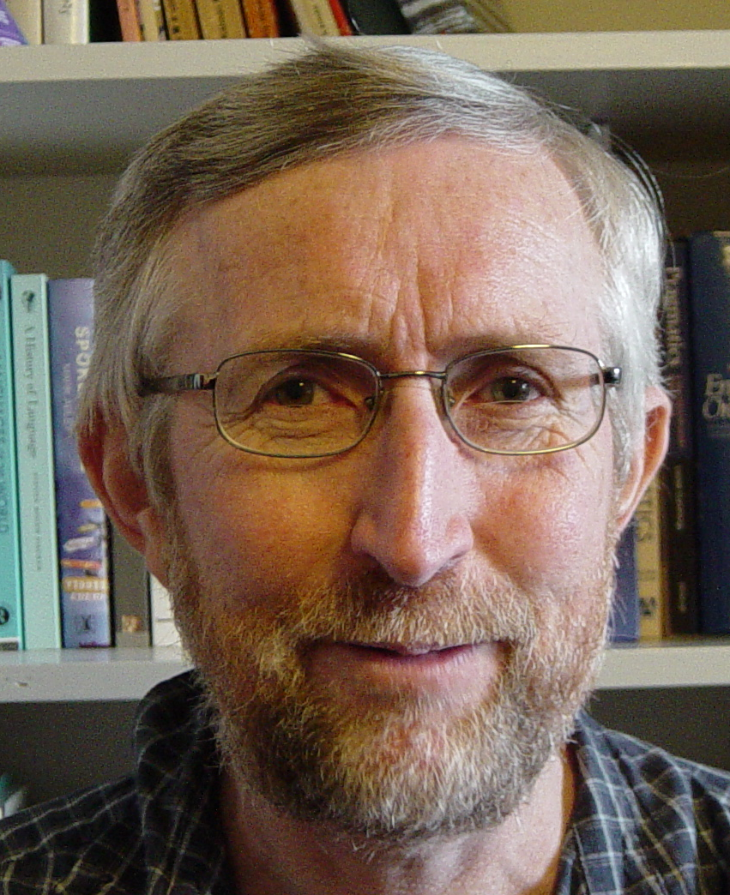
Noun classifiers and Verb classifiers
“Numeral” classifiers are really noun classifiers
Classifiers are “unitizers” that construe the referents of mass nouns as countable units, i.e., count nouns.
Sortal classifiers “sort” the nouns of the language into groups according to the units that the substances typically form, often according to their shape: long objects, flat objects, round objects, etc.
Mensural classifiers create non-inherent units of mass nouns by using measures: a bit, a cup, etc.
Linguists have only recently begun to describe verb classifier systems

Slide 26
Russian Prefixes are Verb Classifiers
Russian prefixes -- “unitizers”, designate discrete events
Russian prefixes -- quantification by perfective aspect
Resultative uses “sort” the verbs, classification by outcome:
SWELL with раз- as in пухнуть > рас-пухнуть ‘swell’
MOVE AWAY with у- as in красть > у-красть ‘steal’
ATTACH with при- as in липнуть > при-липнуть ‘get stuck to’
Procedural uses create non-inherent units:
SOME with по- as in сидеть > по-сидеть ‘sit for a while’
THROUGH with про- as in плакать > про-плакать (всю ночь) ‘cry all through the night’
SORTAL
classifiers
MENSURAL classifiers

Slide 27
Parallels between Noun and Verb Classifiers
Noun Classifiers
Verb Classifiers
One noun can combine with various classifiers
One classifier may have various functions
Sortal and Mensural classifiers
One verb can combine with various classifiers
One classifier may have various functions
Sortal and Mensural classifiers

Slide 28

One noun may combine with various classifiers
Burmese myiʔ ‘river’ (Becker 1975)
a. myiʔ tǝ myiʔ
river one cl:river
‘a river [default case]’
b. myiʔ tǝ yaʔ
river one cl:place
‘a river as site [for a picnic, etc.]’
c. myiʔ tǝ tan
river one cl:line
‘a river [on a map]’
d. myiʔ tǝ hmwa
river one cl:section
‘a river section [for fishing, etc.]’
e. myiʔ tǝ 'sin
river one cl:distant arc
‘a river as path to the sea’
f. myiʔ tǝ θwe
river one cl:connection
‘a river as a connection [linking villages]’
g. myiʔ tǝ ‘pa
river one cl:sacred object
‘a river [in mythology]’
h. myiʔ tǝ khu’
river one cl:conceptual unit
‘a river [in a discussion of rivers in general]’

Slide 29

One verb may combine with various prefixes
Russian:
писать ‘write’
> на-писать ‘write’ Natural Perfective
>> в-писать ‘write in, insert’ Specialized Perfective
>> за-писать ‘record, register’ Specialized Perfective
Czech:
psát
> na-psat
>> ve-psat
>> za-psat
Polish:
pisać
> na-pisać
>> w-pisać
>> za-pisać
BCS:
pisati
> na-pisati
>> u-pisati
>> za-pisati
Bulgarian:
пиша
> на-пиша
>> в-пиша
>> за-пиша
Late Common Slavic:
pьsati
> na-pьsati
>> vъ-pьsati
>> za-pьsati

Slide 30

One classifier may have various functions
HIGH semantic overlap between classifier and noun => default classifier
LOW semantic overlap between classifier and noun => other classifier
Mandarin Chinese classifier pian expresses flatness (Zhang 2013: 42):
a. san pian shuye (sortal classifier)
three cl:slice leaf
‘three leaves’
b. yi pian qiche (mensural classifier)
one cl:slice car
‘one group of cars’
c. san pian mutou (mensural classifier)
three cl:slice wood
‘three pieces of wood’
d. she pian luobo (mensural classifier)
ten cl:slice carrot
‘ten slices of carrot’

Slide 31
One prefix may have various functions
Natural Perfectives
пухнуть ‘swell’ > рас-пухнуть ‘swell’
красть ‘steal’ > у-красть ‘steal’
липнуть ‘stick’ > при-lлипнуть ‘stick’
ночевать ‘spend the night’ > пере- ночевать ‘spend the night’
HIGH DEGREE OF OVERLAP:
Natural Perfectives only change the aspect
Specialized Perfectives
дуть ‘blow’ >> раз-дуть ‘inflate’
бежать ‘run’ >> у-бежать ‘run away’
вязать ‘tie’ >> при-вязать ‘tie onto’
ждать ‘wait’ >> пере-ждать ‘wait through something’
LOW DEGREE OF OVERLAP:
Specialized Perfectives change the aspect and the meaning

Slide 32


Sortal vs. Mensural Classifiers
The Numeral Classifier Construction in Mandarin Chinese
Classifier Type | Numeral | Classifier | Noun
Sortal | yi ‘one’ | tiao cl: long-thin | shengzi rope
Mensural | yi ‘one’ | bei cl: glass | pijiu beer
(Gao & Malt 2009)
Morpho-syntactic behavior is identical
Both types signal units
Sortal: refer to inherent units
Mensural: create units, individuate in terms of quantity
A single classifier can serve both sortal and mensural functions
General classifiers often serve both functions

Slide 33
Sortal & Mensural Classifiers for Nouns and Verbs
Unitizer Type: | NOUNS Numeral Classifier | VERBS Aspectual Prefix
Reference to inherent boundaries: | Sortal Classifiers | Lexical + purely perfectivizing prefixes (Natural Perfectives and Specialized Perfectives)
Imposition of external boundaries: | Mensural Classifiers | Procedural prefixes, a.k.a. Superlexical, Aktionsart prefixes (Complex Act Perfectives and Single Act Perfectives)

Slide 34


Procedural Prefixes as Mensural Classifiers
(1) a. yi bei pijiu (Mandarin Chinese: Gao and Malt 2009: 1129)
one cl:glass beer
‘a glass of beer’
(1) b. ’um- p’íit há’as (Yucatec Maya; Lucy 1992: 74)
a cl:little-bit/some banana
‘a little bit of/some banana’
(2) a. по- сидеть (Russian)
SOME sit
‘sit for a while’

Slide 35
Russian Examples of Sortal and Mensural Classifiers
Type of Classifier | Russian Perfectivizing Prefixes | Russian Examples
(1) Individual Classifiers (Sortal) | Natural по-, с-, за-, etc. Specialized до-, с-, за-, etc. | по-строить ‘build’, с-варить ‘cook’, за-крепить ‘fasten’ до-писать ‘finish writing’, со-брать ‘collect’, записать ‘register’
(2) Collective Classifiers (Mensural) | Distributive пере-, по- Cumulative на- | пере-пробовать ‘try a series of things’, по-бросать ‘throw a lot of things’ на-грешить ‘commit a lot of sins’
(3) Individuating Classifiers (Mensural) | Delimitative по- Perdurative про- Attenuative при-, под- Ingressive за- Finitive oт- Intensive-Resultative до-…-ся, за-…-ся, etc. | по-сидеть ‘sit for a while’ про-плакать ‘cry all through a period of time’ при-тормозить ‘brake att’, под-сохнуть ‘dry att’ за-говорить ‘start to talk’ от-служить ‘complete a tour of duty’ до-плясаться ‘dance one’s feet off’, за-работаться ‘get lost in one’s work’
(4) Partitive Classifiers (Mensural) | Semelfactive с-, -ну- | с-глупить ‘do one stupid thing’, чих-нуть ‘sneeze once’

Slide 36
Conclusion
Slavic aspectual prefixes form Prefix + Verb constructions
Prefixes are polysemous, with radial category structure
Path meanings are found with motion verbs and are prototypical
Other meanings are related to path meanings via metaphor and metonymy
Meanings of prefixes combine with meanings of verbs
Contrast
Compatibility
Overlap (Natural Perfectives)
Prefixes can be understood as verb classifiers, similar to noun classifiers
One verb may combine with various prefixes
One prefix may have various functions
Sortal and Mensural Classifiers

